Slide 1


Priyadarshini college of engineering Nagpur (4123)
Project Title : Home Service Finder
Presented by -
Sr. No. Students Name
1. PREM S. RAHANGDALE
2.
3.
4.
Guided by -
Mr. …………….. Sir

Slide 2


Content
Abstract
Introduction of project
Project Survey
Tools and Technology used
Project Output

Slide 3

Introduction
1. In our project, we developed an online home services finder application which helps to solve the various day to day problems.
Our application provides the services for the following problems:
Room Rent Service
Cleaning Service
Mechanic Service
Electrician Service
Plumber Service
Painter Service

Slide 4

1. Room Rental Service
Description : When you're looking for a room to rent, our app will make it easy to find safe and comfortable places to live.
Key Benefits : Secure bookings, verified hosts, budget-friendly options.

Slide 5

2. Cleaning Service
Description : For those who prefer a clean home without the work, our housekeeping services will offer flexible scheduling and thorough cleaning once the app is operational.
Key Benefits : Custom scheduling, deep cleaning, skilled housekeepers

Slide 6

3. Electrician Service
Description: Similarly, once the app is developed, our electricians will be available to assist you with electrical problems any time of day. They'll prioritize safety and provide energy-efficient solutions.
Key Benefits: 24/7 availability, safety-focused, energy-efficient.

Slide 7

4. Mechanic Service
Description: “Home Service Provider" will help you find a reliable mechanic for your car repairs. They'll be certified, quick, and cost-effective.
Key Benefits: Quick response, certified technicians, affordability.

Slide 8

5. Painter Service
Description: In the future, if you face house painting issues, "Service Finder" will connect you with painters who can quickly resolve problems like wall damage.
Key Benefits: Rapid response, damage detection, cost-effective solutions.

Slide 9

6. Plumber Service
Description: In the future, if you face plumbing issues, "Service Finder" will connect you with plumbers who can quickly resolve problems like leaky pipes, clogs, and water heater issues.
Key Benefits: Rapid response, leak detection, cost-effective solutions.

Slide 10
Project Survey
DAYS | Content | Users and Providers
DAY 01 | We check How many users and providers used our application | 01 User 00 Provider
DAY 02 | Our application was marketed only in College Campus | 09 Users 01 Provider
DAY 5 | Our application was marketed only in Gondia City | 13 Users 04 Providers
DAY 10 | One day we take our application and go to the market and promote our app and tell them about our app. | 22 Users 10 Providers

Slide 12


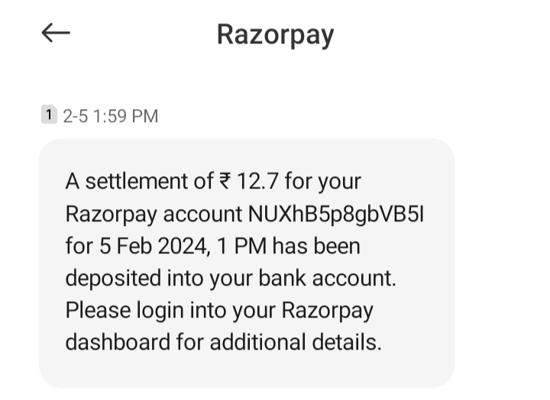
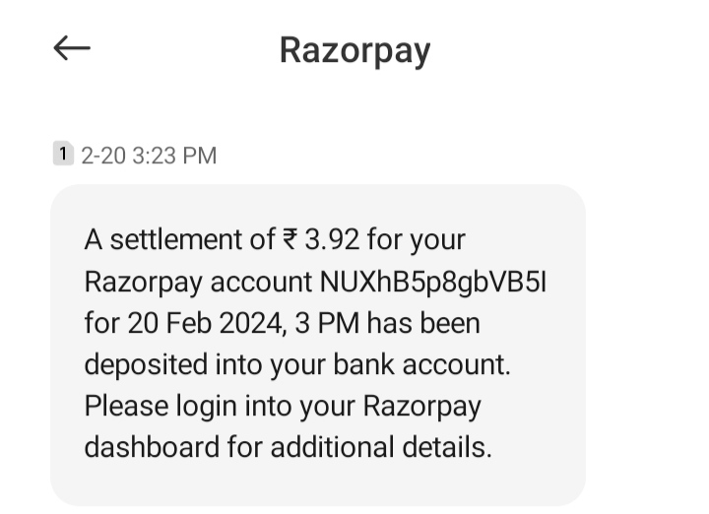
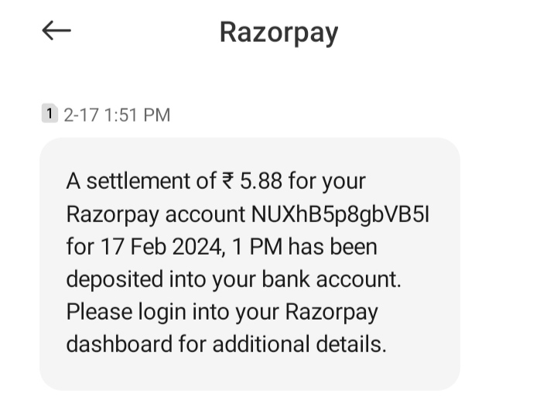
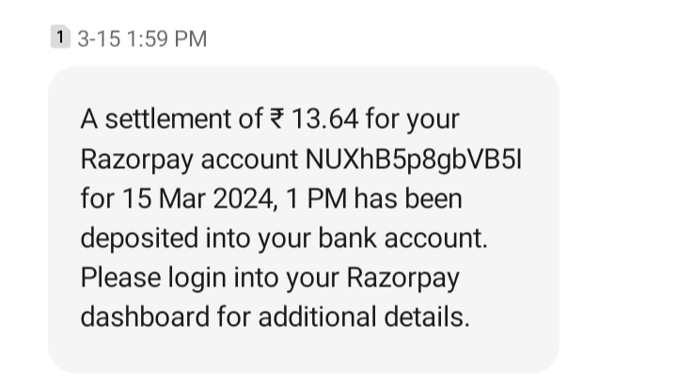
Payment statement

Slide 13
Tools and Technology used
Tools used (if hardware used with specification)
Laptop ASUS Vivobook 15 (Intel i3 11th gen, 8GB RAM, 512GB SSD)
Computer System (Intel i5 10th gen, 8GB RAM, 128GB SSD, 500GB HDD)
Technology used (Software used / database)
Android Studio
Star UML
Firebase (used for store data)
Razor pay (used for Online Payment)
Google Form (used for getting reviews)
Microsoft Word (used for report writing)
PowerPoint (used for PPT making)

Slide 14

User Registration Process
Name
Email
Create
Mobile
Users
Account
Address
Password

Slide 15
Service Provider Registration Process
Address
Payment
Image
Create
Name
Provider
Account
Email
Category
Password

Slide 16
Flowchart (Module Interaction):
USERS
ADMIN LOGIN
CUSTOMER LOGIN
Provider LOGIN
Add a new Provider to DB
Delete a Provider from DB
Update Provider DB values
Delete DB
New Registration
Accept any User Request
Reject User Request
Update details in DB
New Registration
Profile Check
Find and Select any Service
Change Password
Reset Password
Request any Service

Slide 17
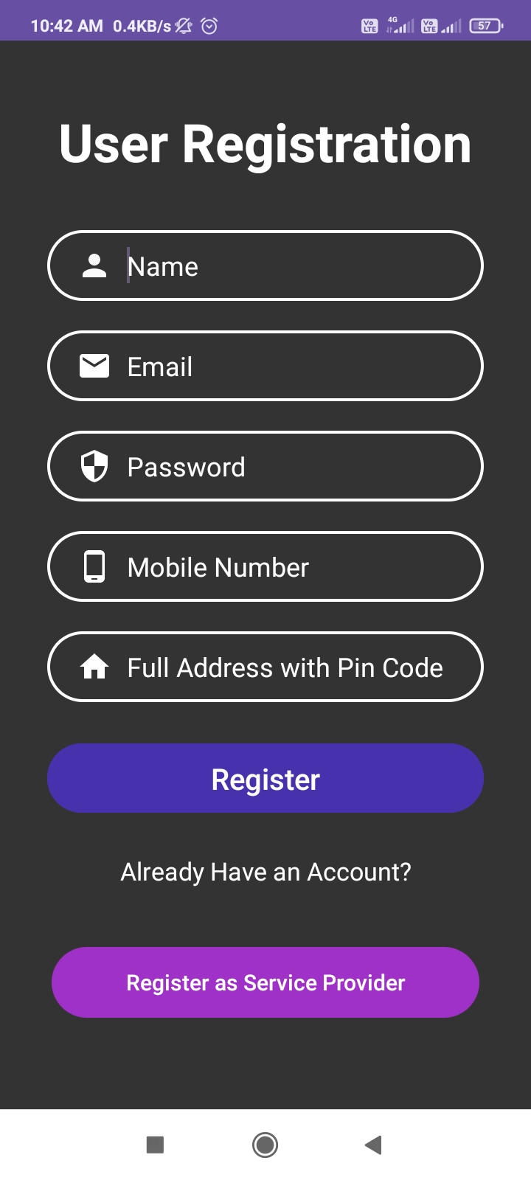
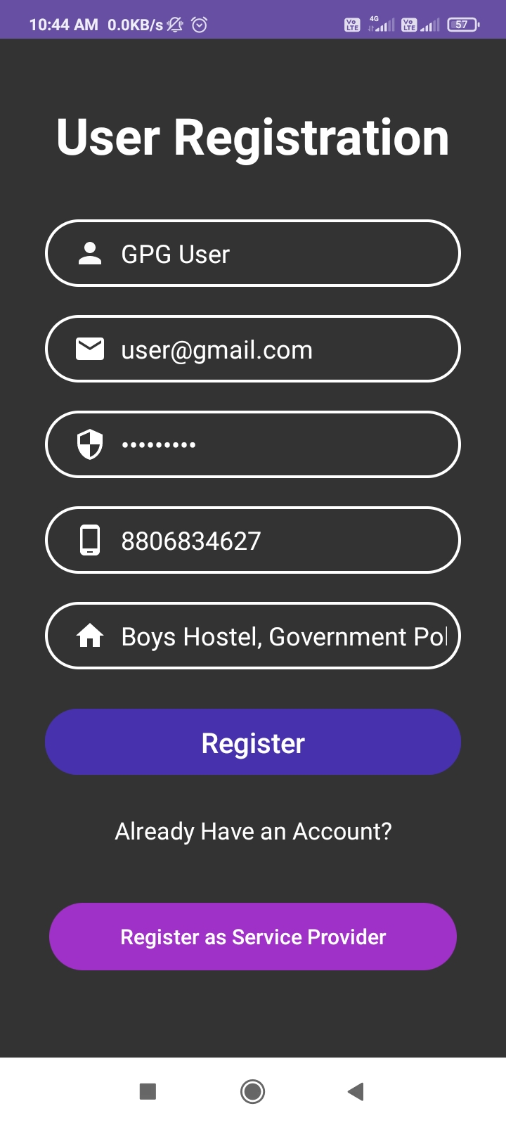
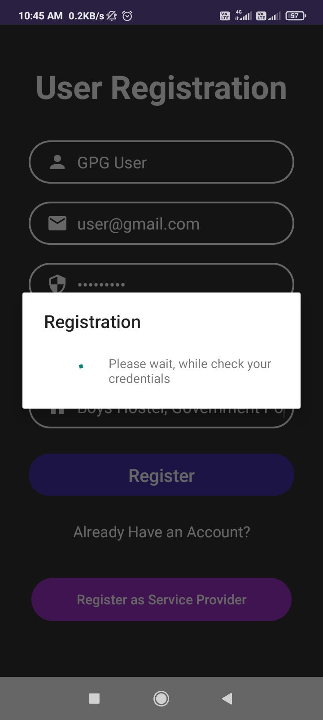
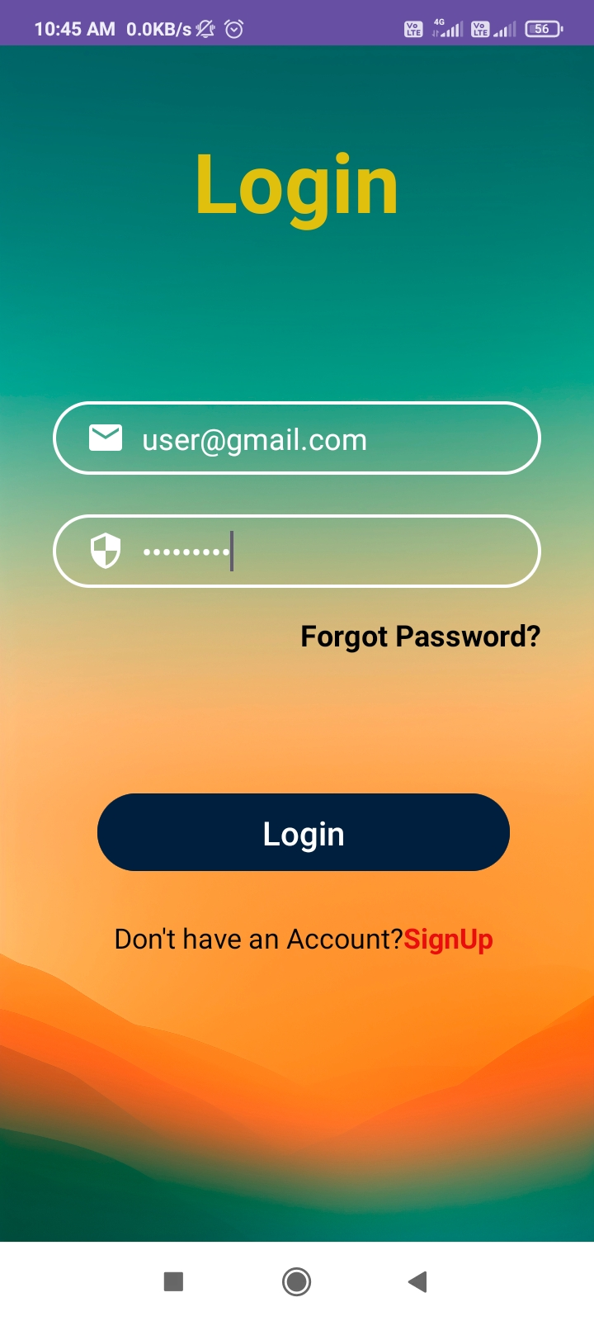
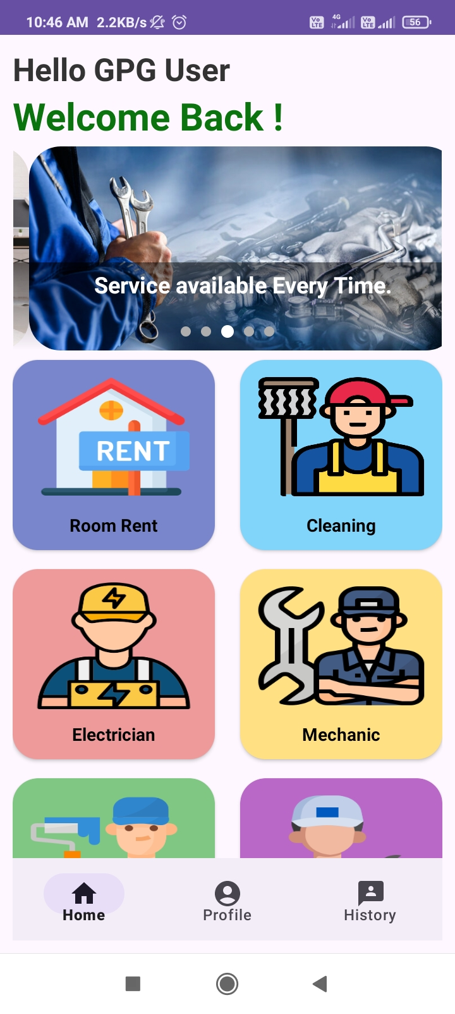
User Login

Slide 18
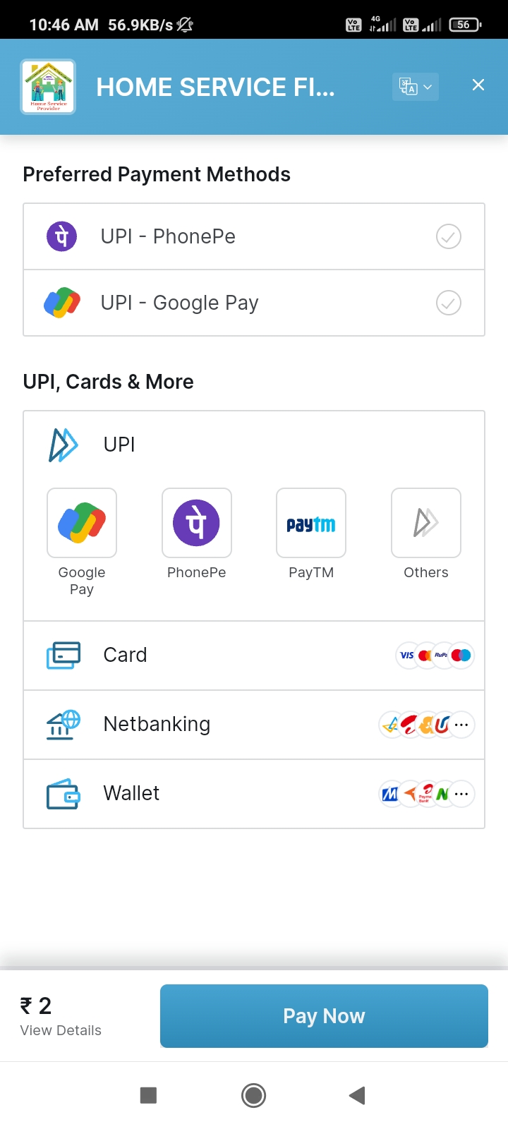
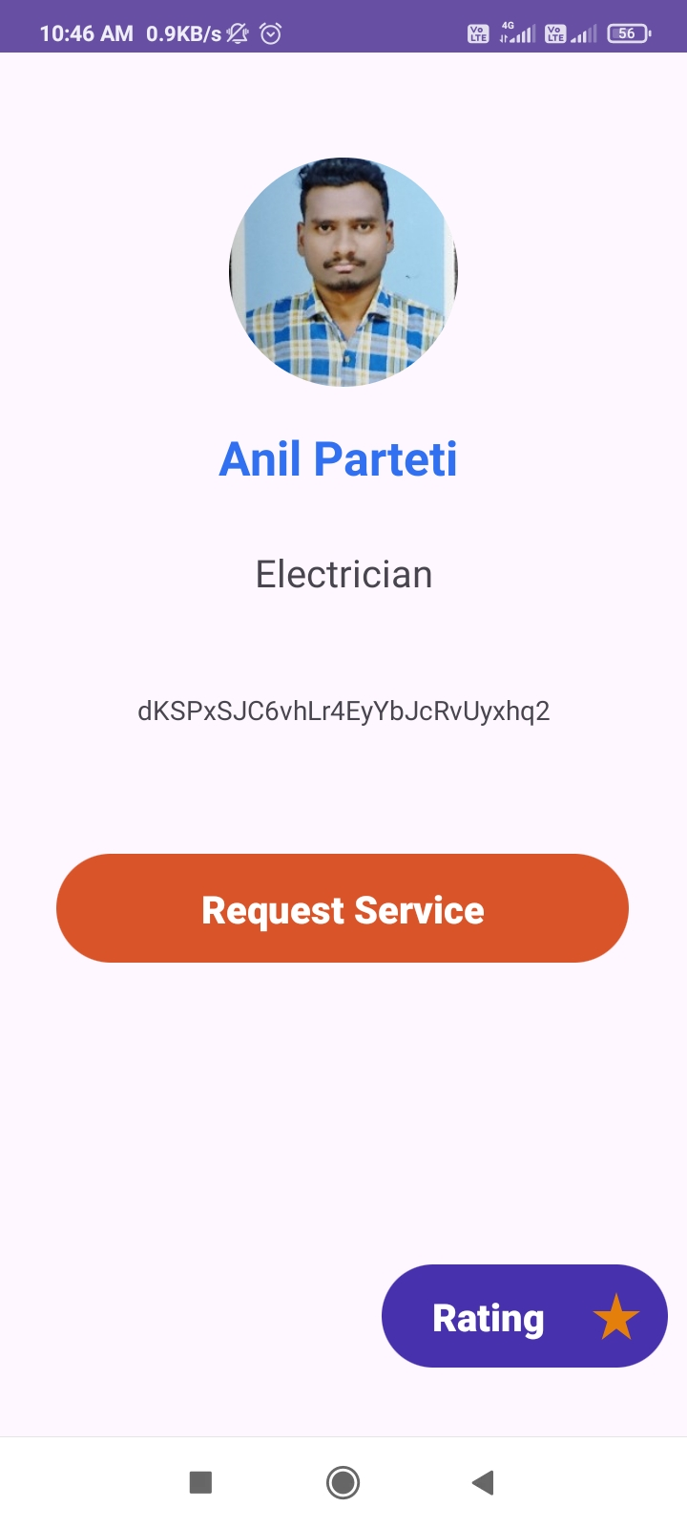
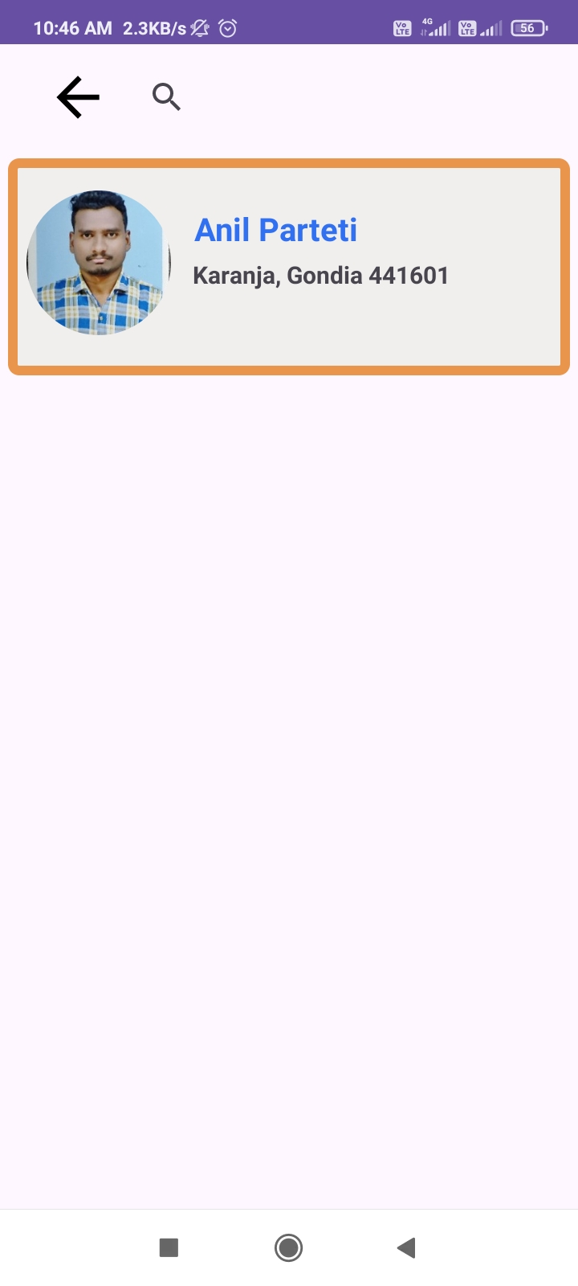
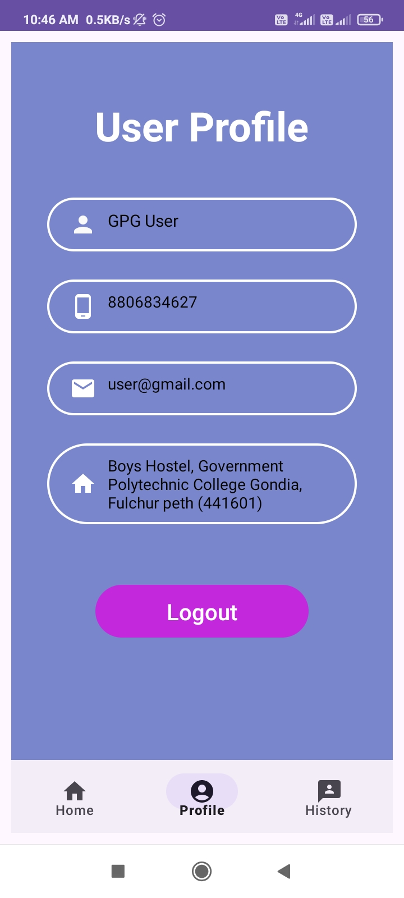
User PANEL

Slide 19
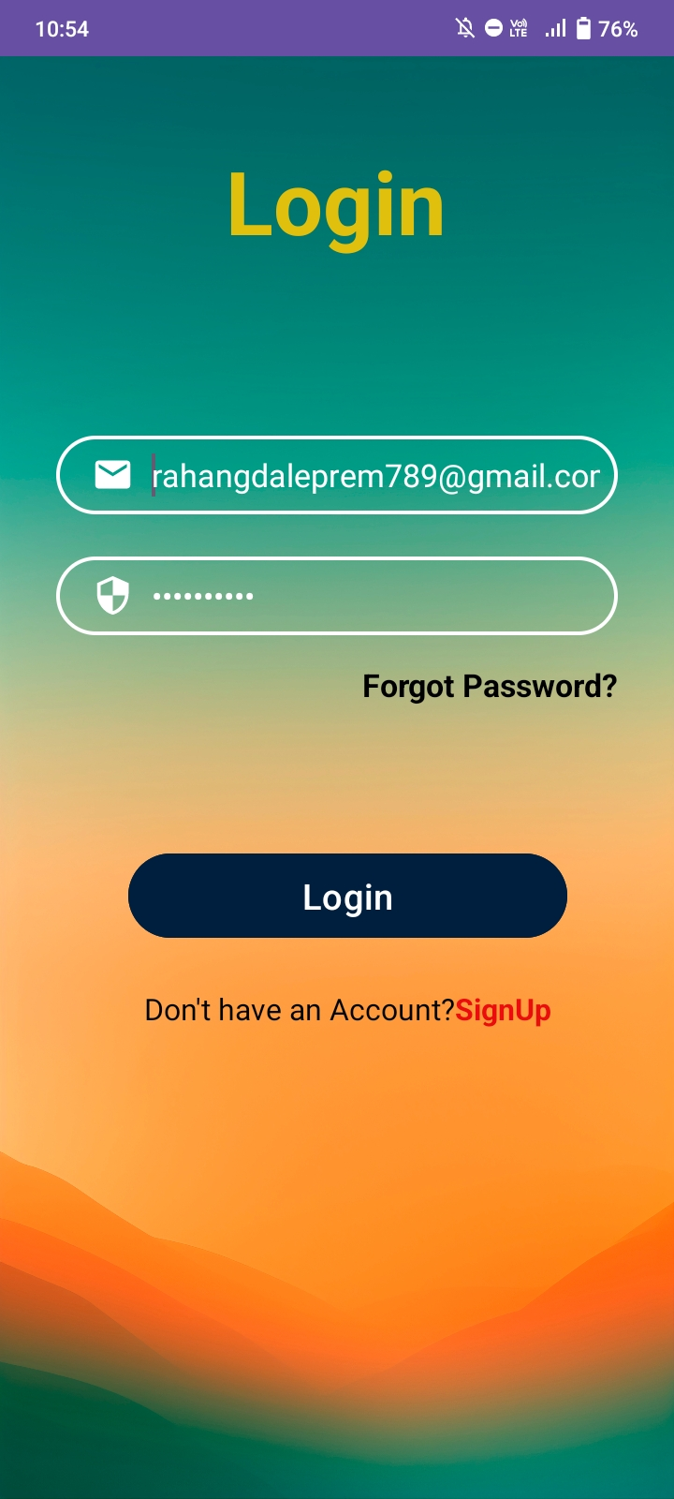
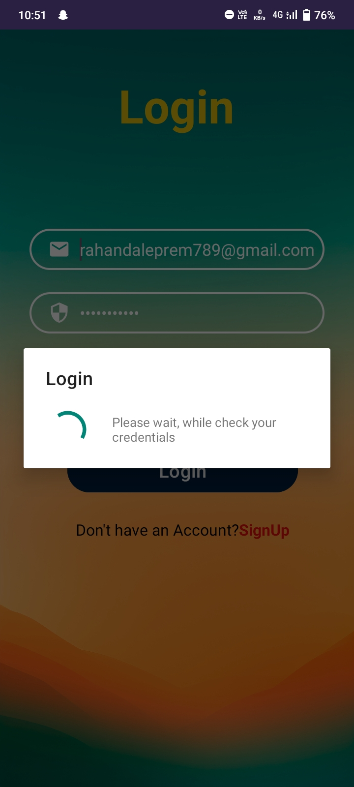
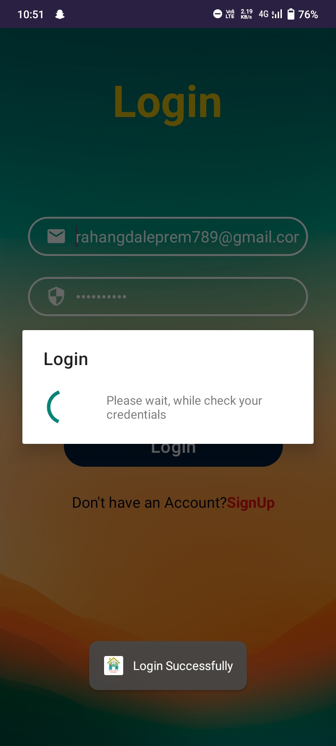
Admin Login

Slide 20
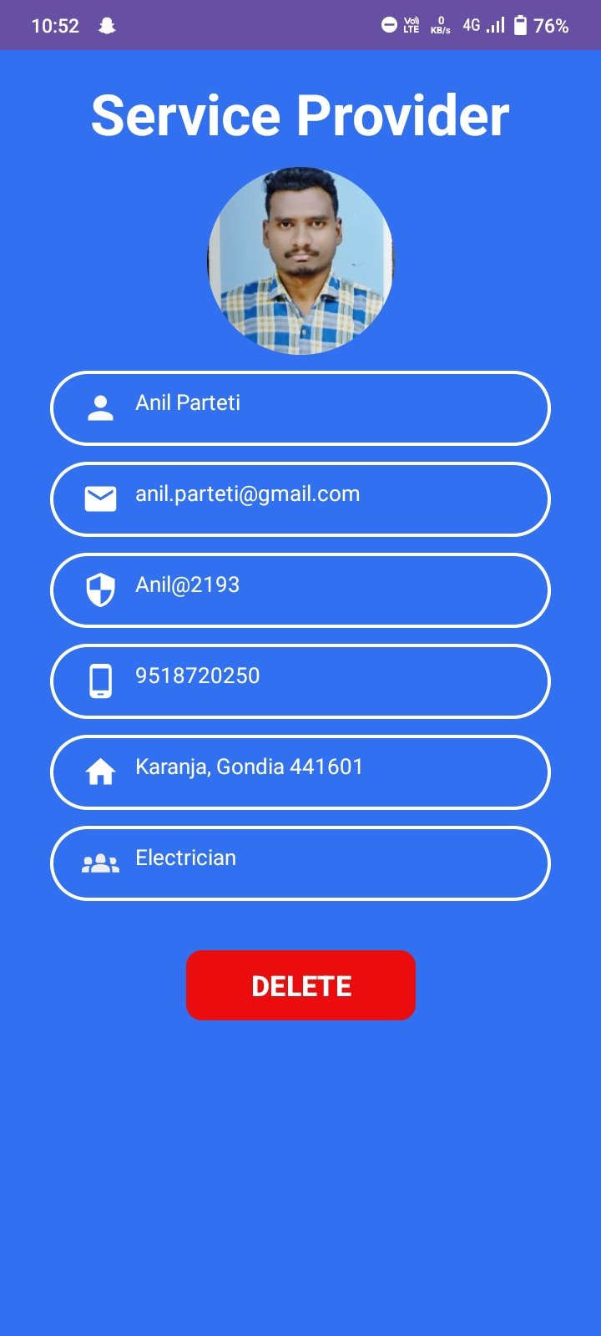
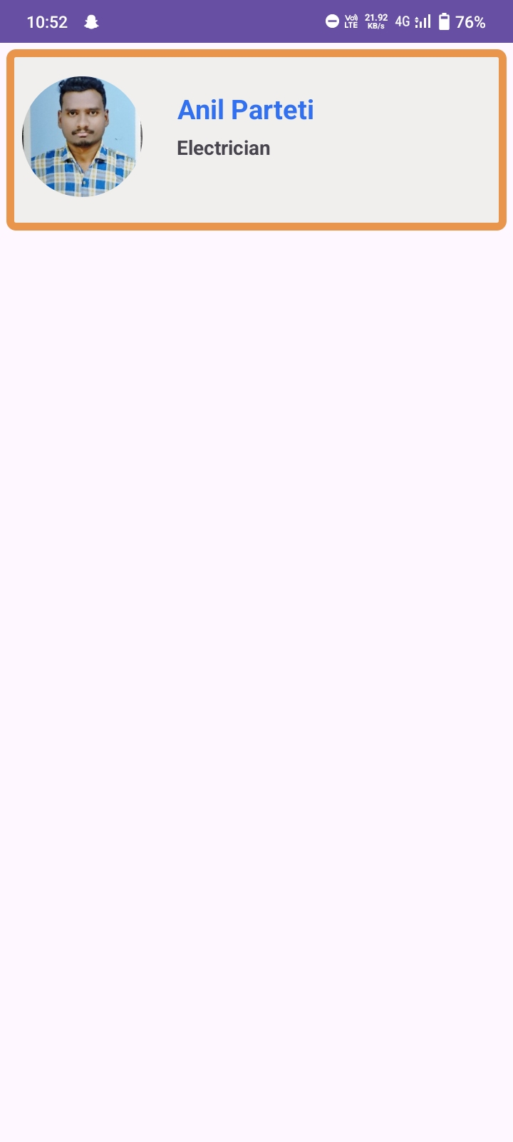
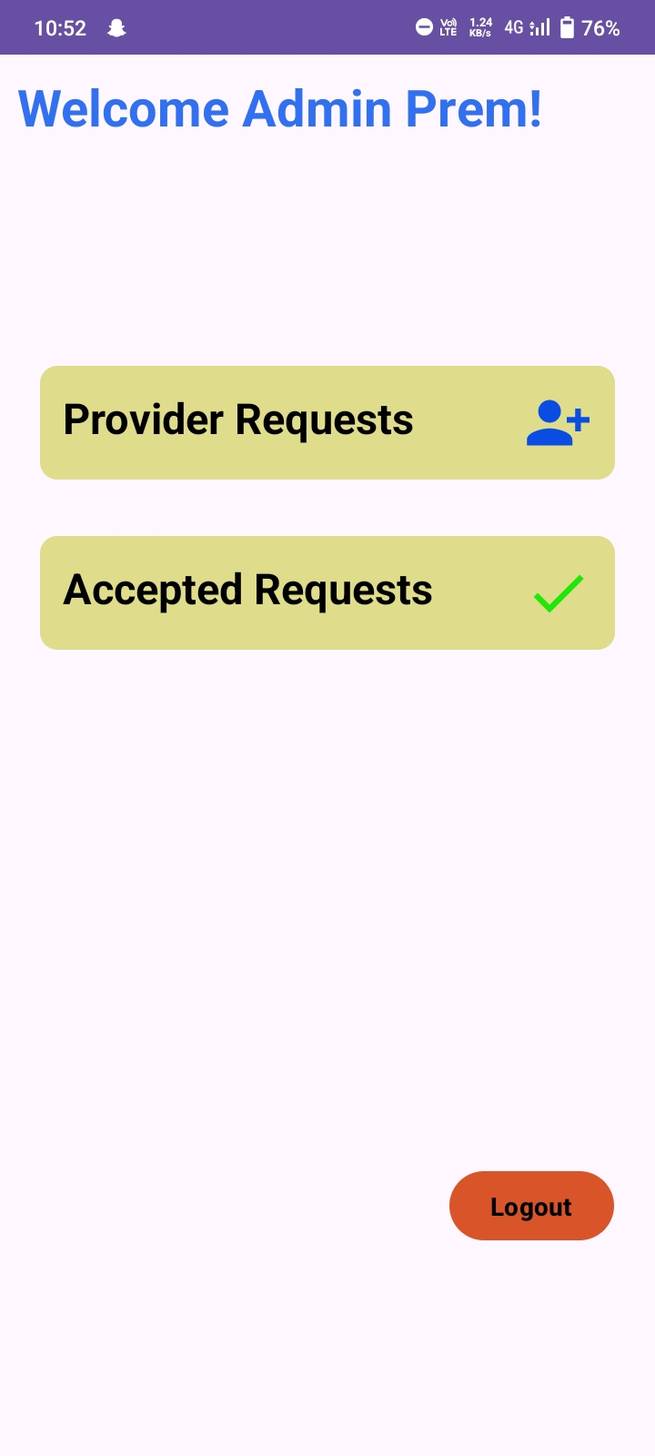
Admin PANEL

Slide 21

Thank you

